Slide 1

Students’ Association and Student Voice.
August 2024 Board Report.

Slide 2

NCLSA 24/25
The Students’ Association (SA) serves as the representative body for all students of New College Lanarkshire (NCL). We act as a bridge between students and the college.
Starting in September, our three new presidents will be visiting classes to introduce themselves and present their manifestos for the year. This is an exciting opportunity for them, and we look forward to updating you on their progress in our next report.
Meet our new presidents

Slide 3
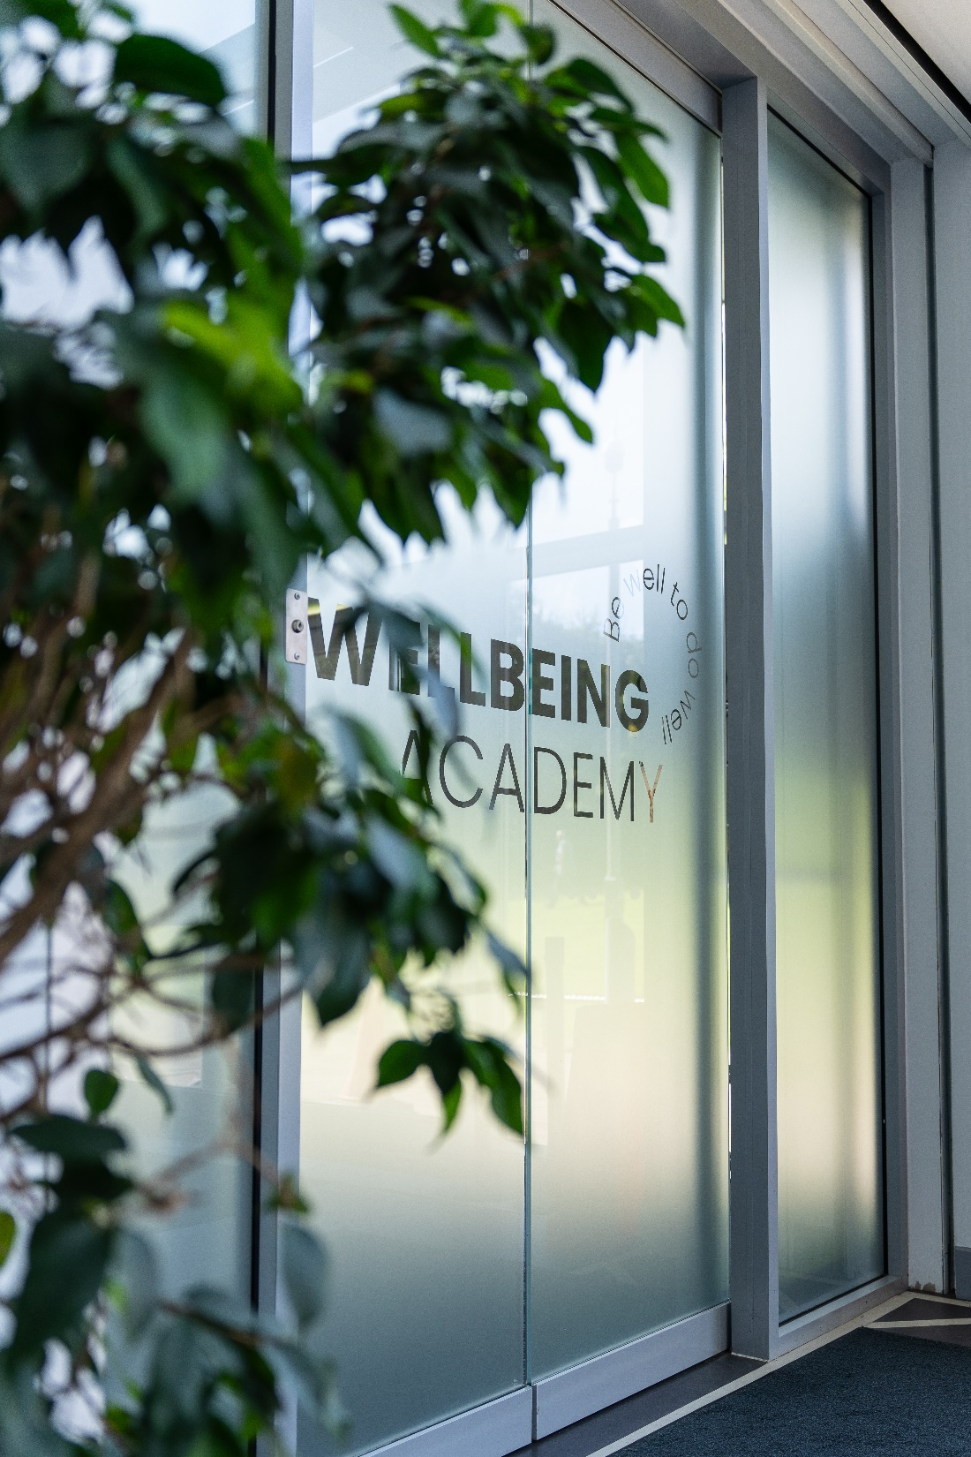

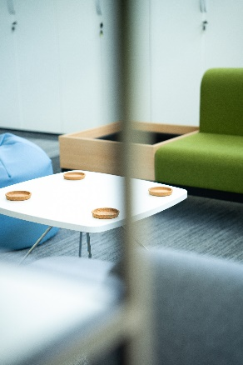
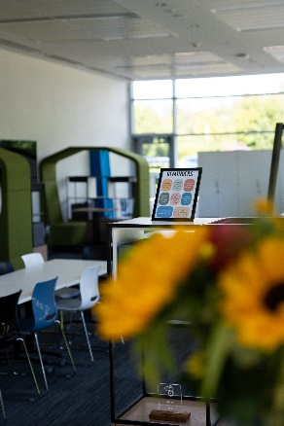
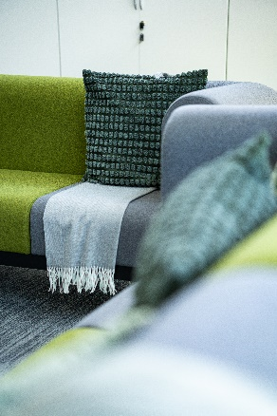
The "Be Well to Do Well" project at NCL focuses on student well-being, which we believe is key to academic and personal success.
This year, we’re excited to open our flagship Wellbeing Academy at our Motherwell Campus, with two more at Coatbridge and Cumbernauld Campuses in development.
These centres will be crucial for our holistic approach to education, providing safe spaces and support through multi-agency services. Inspired by similar initiatives at Niagara College, our aim is to meet the diverse needs of our students and help them succeed both academically and personally.
If you would like to find out more please email studentvoice@nclan.ac.uk

Slide 4
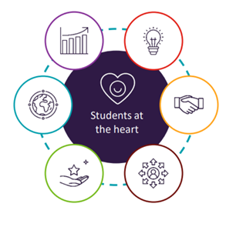
That’s Quality
The New Presidents and Learner Engagement attend annual That's Quality! programme for student officers and students’ association got off to a great start on Thursday 6th July, concluding with a 2-day residential event on Monday 7th and Tuesday 8th August.
The event is split into three parts:
The first part of That’s Quality! is a half-day, sector-specific online event
The second part is an online self-study module, providing officers with a more detailed overview of quality in Scotland and is designed to be used throughout an officer’s time in office.
Finally, attendees of both events come together for a joint, two-day, in-person training event in August. The two-day event is residential, with a dinner on the first evening, allowing for social and networking opportunities.

Slide 5

Class Reps Celebrated.
19 NCL Class reps were treated to a special lunch at Motherwell Campus MLOne last week as a thank you for their work through the year.
NCL Principal and Chief Executive Professor Christopher Moore told those present that ‘being a class rep is a hard job, but it’s such a valuable job, and one I’m hugely grateful for’.
He went on: “The more we hear from students the better we become, and the more we engage the stronger we become. All of your voices make us stronger so this lunch is our way of thanking you for that.”

Slide 6
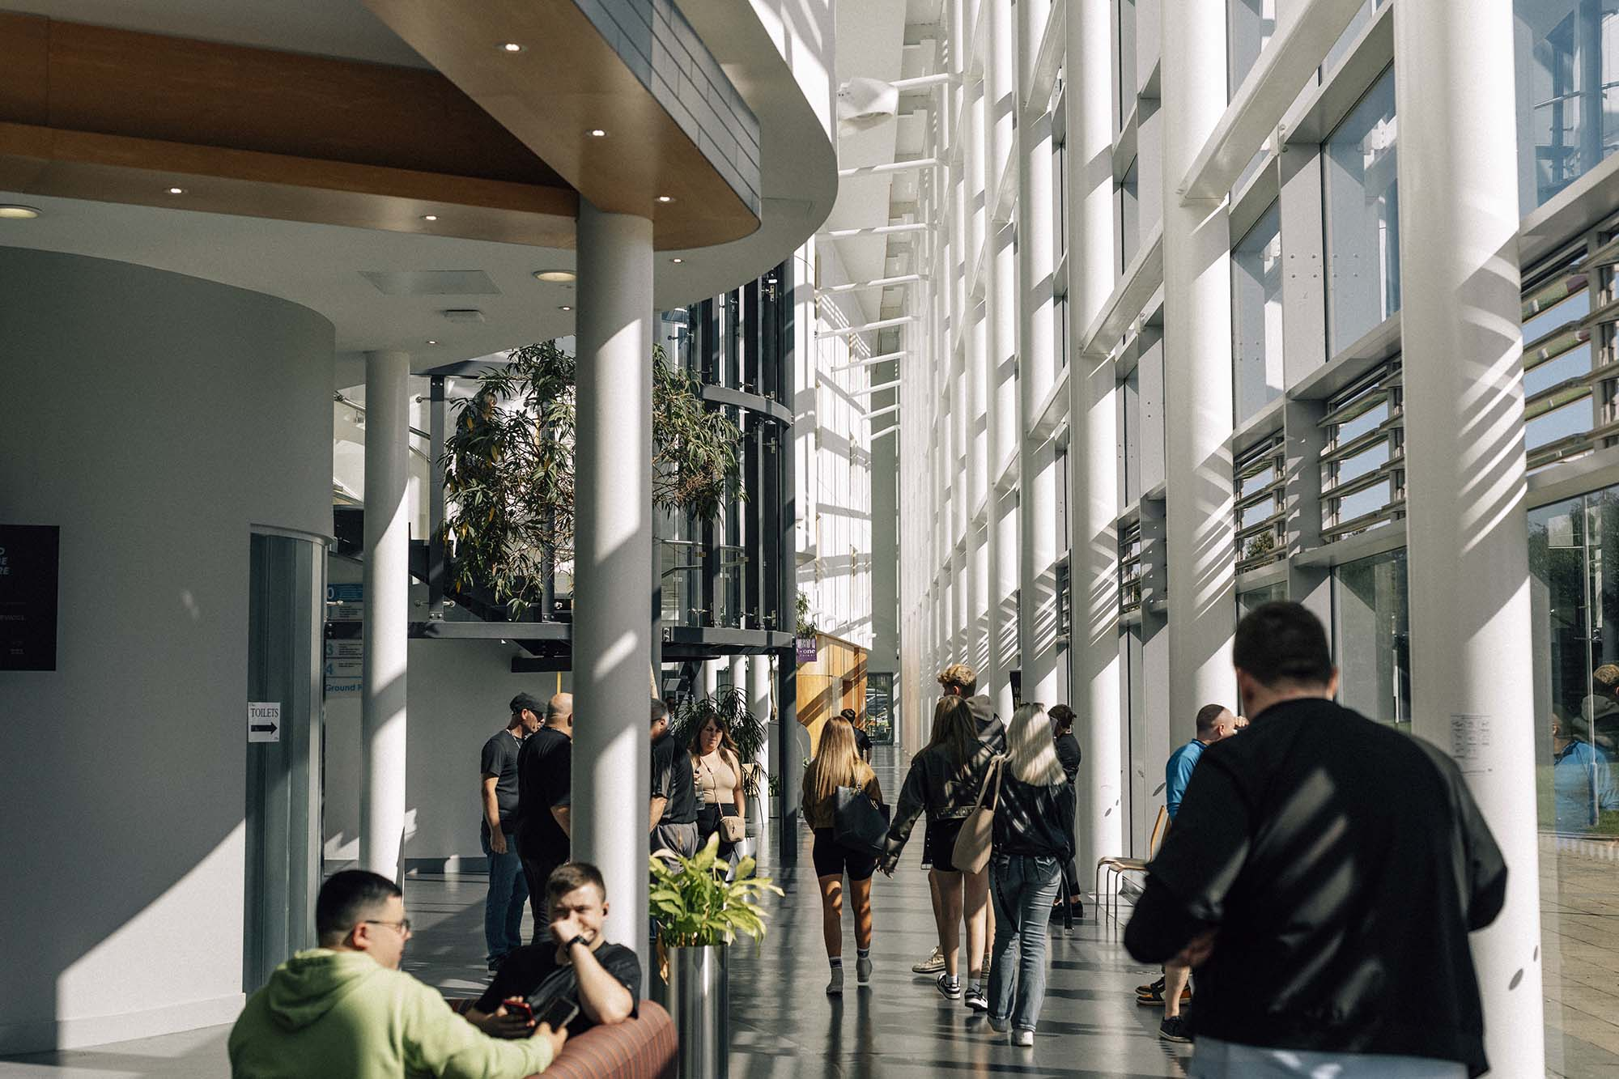
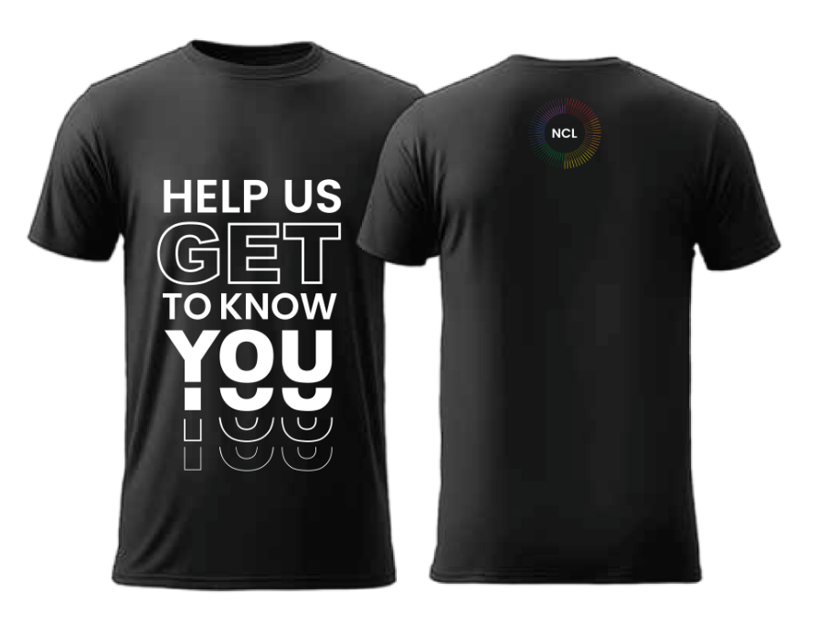
Welcome back.
SASASA
As we prepare for the start of the term, the NCLSA team has been actively engaging with our students on campus. We’ve been listening to their reasons for choosing NCL, their aspirations for the coming year, and the types of support they find most valuable.
Most importantly, we’ve been adding a friendly face to what can be a nervous beginning for some.
We are excited to welcome our students into the Wellbeing Academies and look forward to supporting them throughout their journey at NCL.

Slide 7
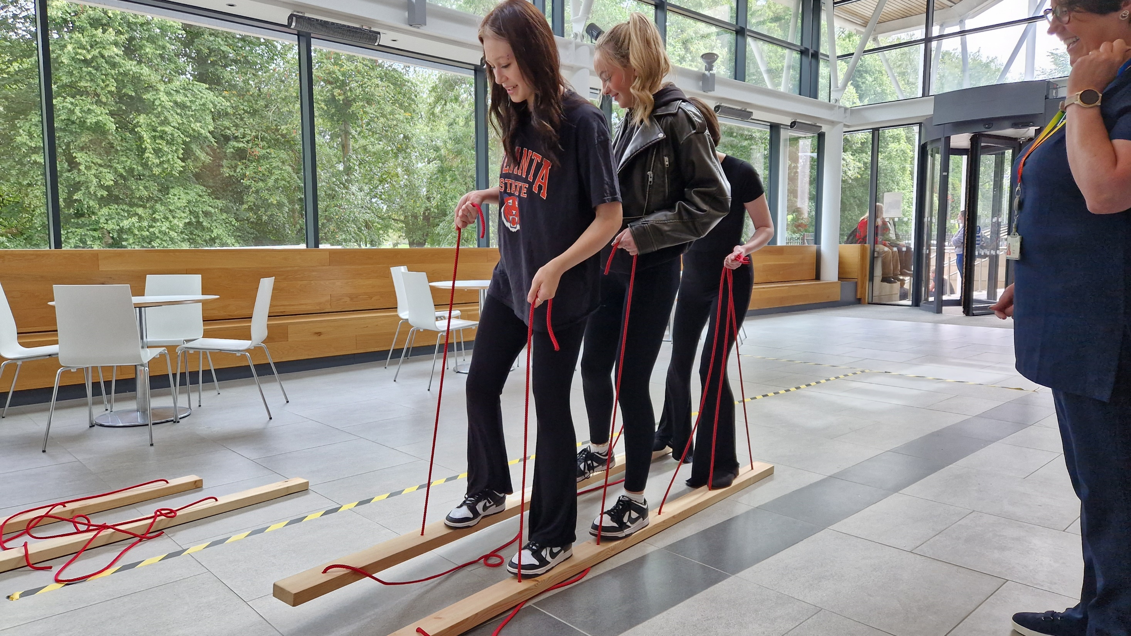
Join the conversation.
Facebook: NCLStudentVoice
Instagram: NCLStudentVoice
Twitter: NCLStudentVoice
Email: studentvoice@nclan.ac.uk

